Slide 2
Adaptive De-Spreading Methods for DSSS Signal in Multipath Channel
Cui Ao, Xu Yuanyuan and Wang Li (Ahmed)

Slide 3
Sect. 1 Introduction

Slide 4
Application| Introduction
一般情况下，一个多径信道的冲激响应
为简化分析，假设多径信道参数在一定时间范围不变，则在此时间段内这个多径信道为广义平稳信道，接收信号已经过理想采样

Slide 5
Application| Introduction
一般情况下，一个多径信道的冲激响应
为简化分析，假设多径信道参数在一定时间范围不变，则在此时间段内这个多径信道为广义平稳信道，接收信号已经过理想采样

Slide 6
Application| Introduction
Fig 1-1, basic architecture of transmitter

Slide 7
Application| Introduction
再假设发射端使用码片(Chip)长度为M的伪随机(Pseudo-Noise)码进行扩频，则扩频后的信号为0序列与1序列所构成的码片在不同时刻上的叠加。

Slide 8
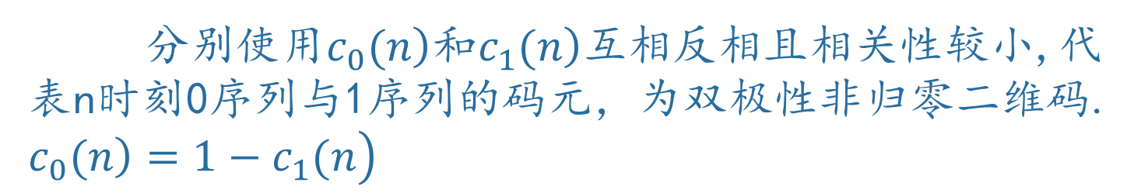
Application| Introduction
分别使用$\left.c_{0}(n\right)$和$\left.c_{1}(n\right)$互相反相且相关性较小,代表n时刻0序列与1序列的码元，为双极性非归零二维码. $\left.\left.c_{0}(n\right)=1−c_{1}(n\right)$

Slide 9
Sect. 2 Adaptive Inverse Modeling

Slide 10
Application| Adaptive Inverse Modeling
Fig 2-1, basic architecture of transmitter

Slide 11
Application| Adaptive Inverse Modeling
Main.m
Script
Fig 2-2, basic architecture of receiver

Slide 12
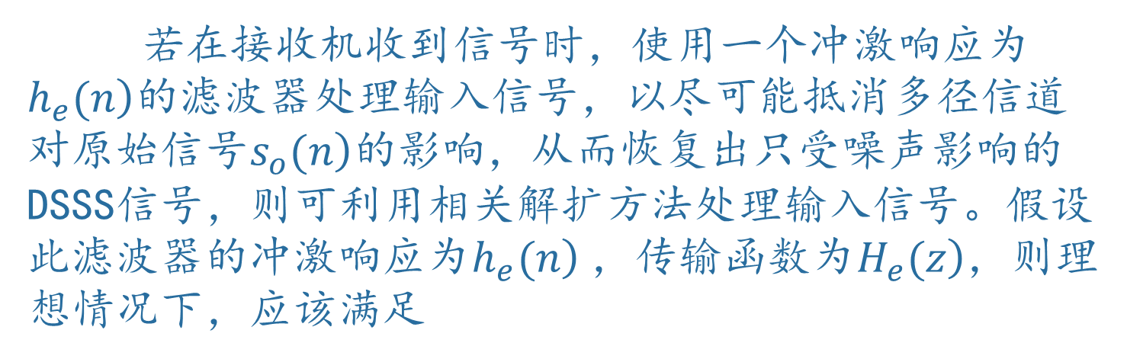
Application| Adaptive Inverse Modeling
若在接收机收到信号时，使用一个冲激响应为$\left.h_{e}(n\right)$的滤波器处理输入信号，以尽可能抵消多径信道对原始信号$\left.s_{o}(n\right)$的影响，从而恢复出只受噪声影响的DSSS信号，则可利用相关解扩方法处理输入信号。假设此滤波器的冲激响应为$\left.h_{e}(n\right)$，传输函数为$\left.H_{e}(z\right)$，则理想情况下，应该满足

Slide 13
Application| Adaptive Inverse Modeling

Slide 14
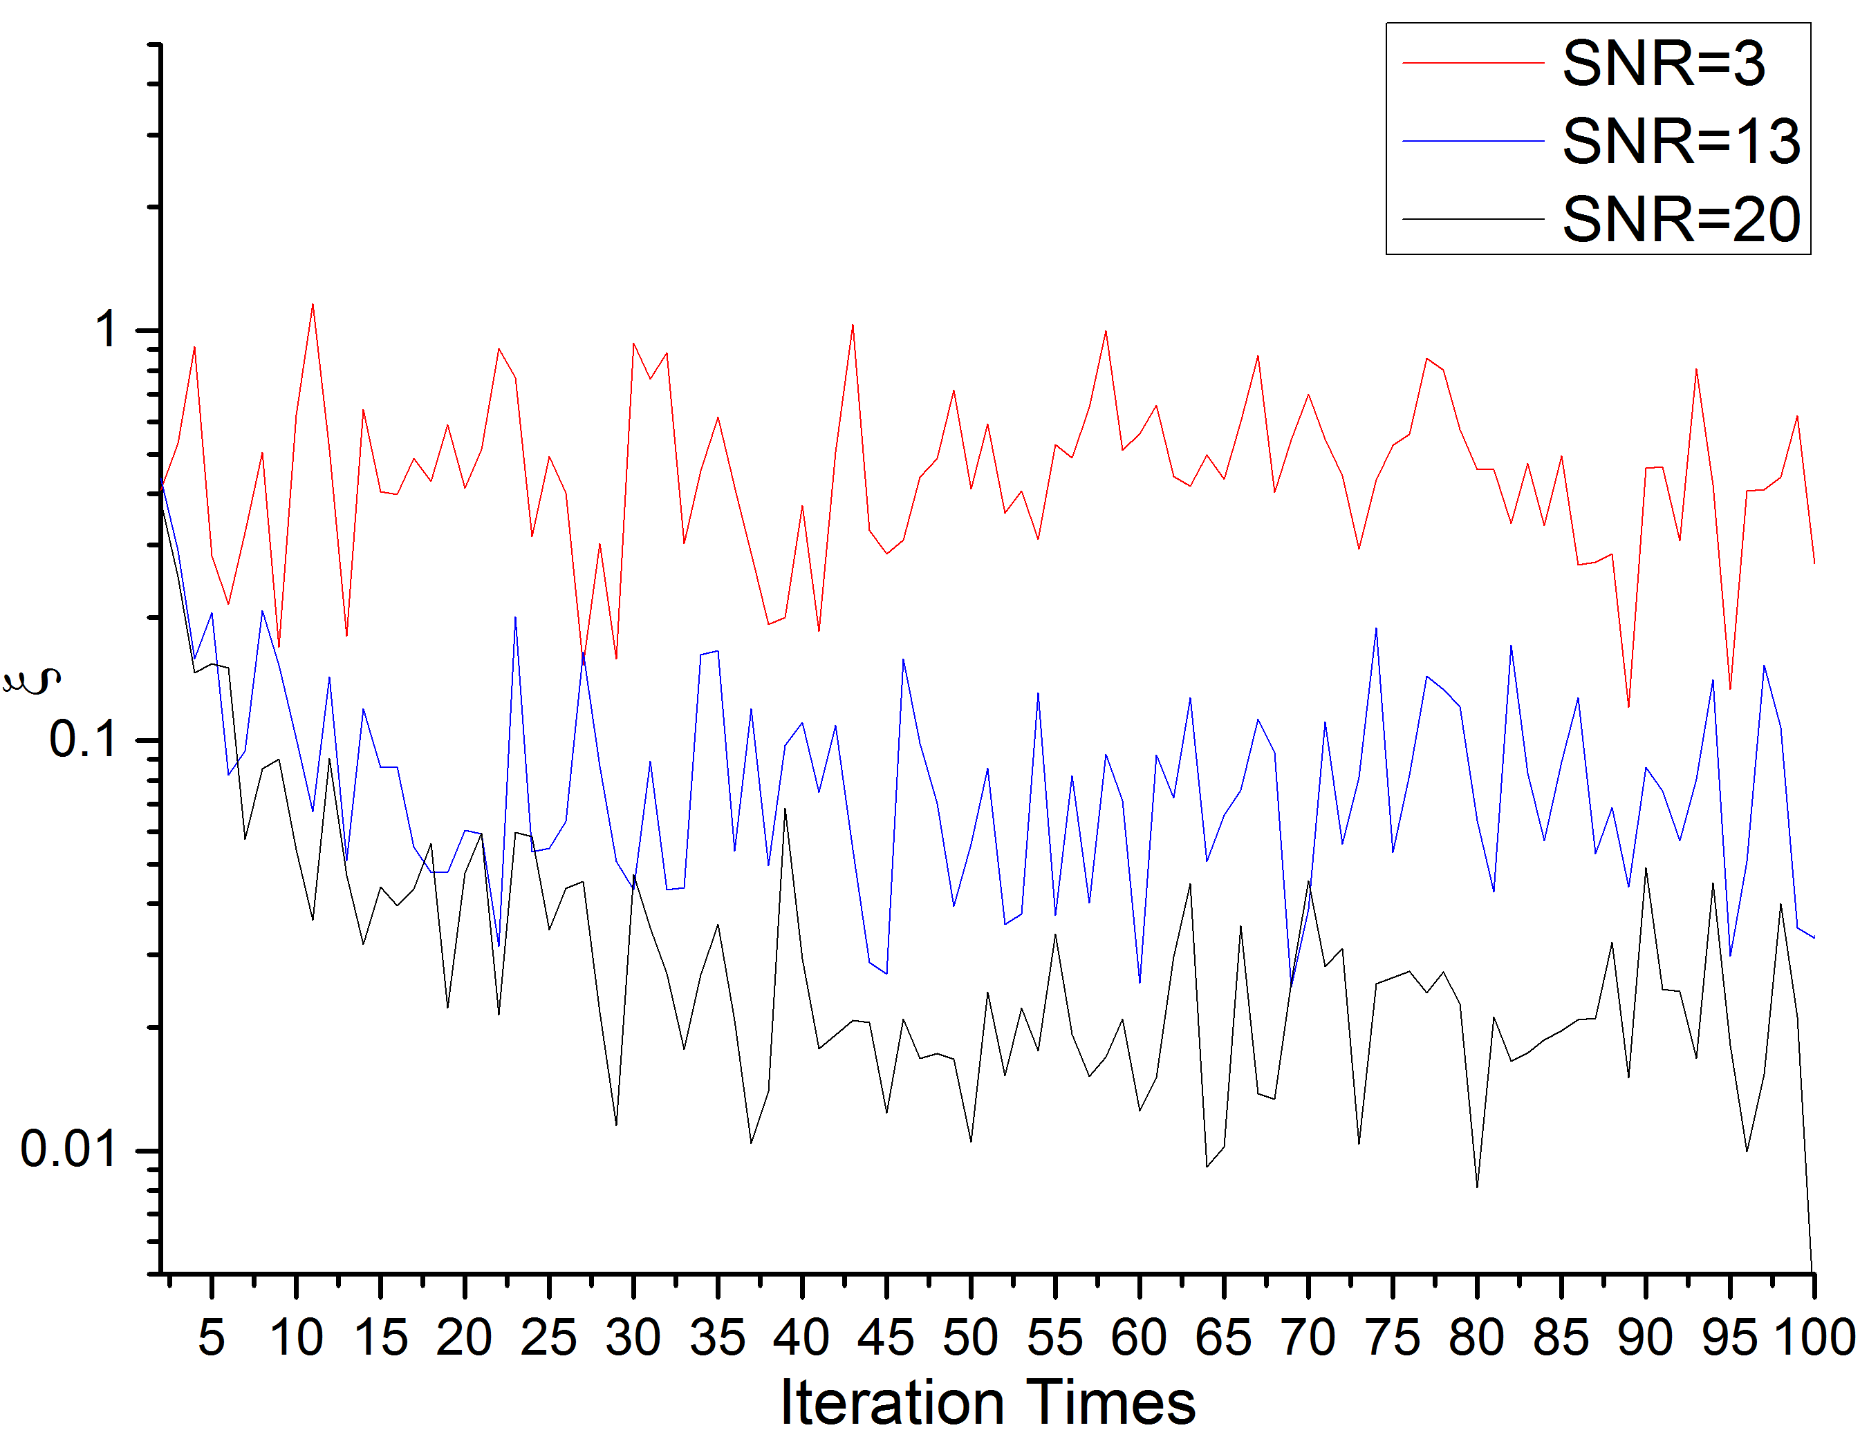
Application| Adaptive Inverse Modeling
Fig 2-3, Learning Curves

Slide 15
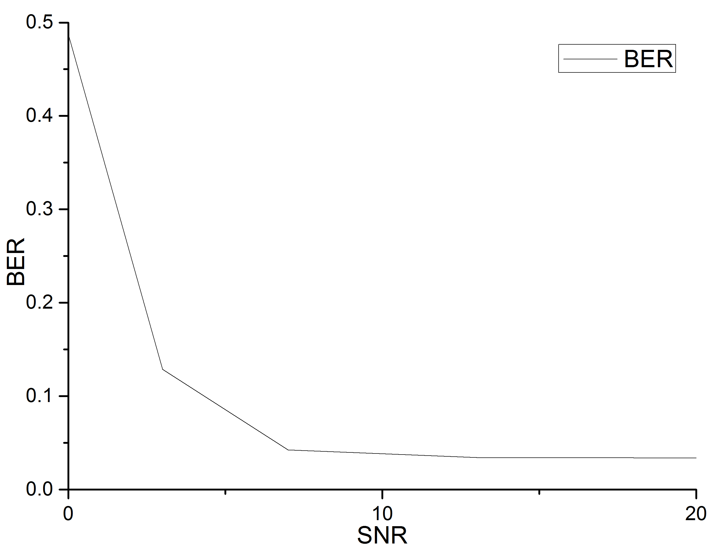
Application| Adaptive Inverse Modeling
Fig 2-4, BER/SNR

Slide 16
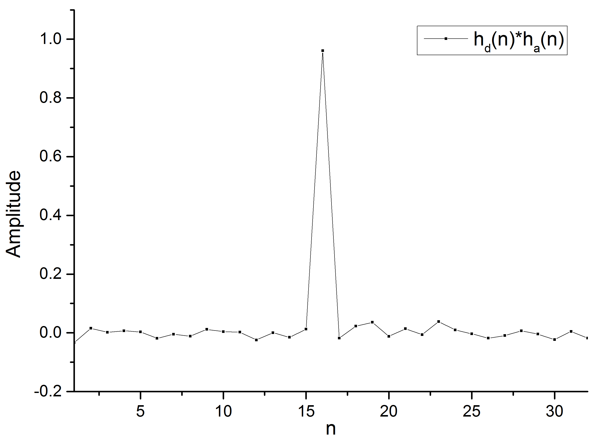
Application| Adaptive Inverse Modeling
Fig 2-5, Convolution of Impulse Responses of Channel and Input Filter

Slide 17
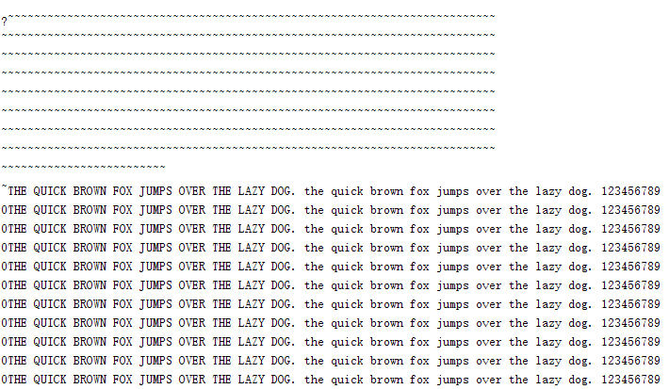
Application| Adaptive Inverse Modeling
Fig 2-6, Messages

Slide 18
Sect. 3 Adaptive Modeling

Slide 19
Application| Adaptive Modeling
Fig 3-1, basic architecture of transmitter

Slide 20
Application| Adaptive Modeling
Main.m
Script
Fig 3-2, basic architecture of receiver

Slide 21
Application| Adaptive Modeling

Slide 22
Application| Adaptive Modeling

Slide 23
Application| Adaptive Modeling

Slide 24
Application| Adaptive Modeling

Slide 25
Application| Adaptive Modeling

Slide 26
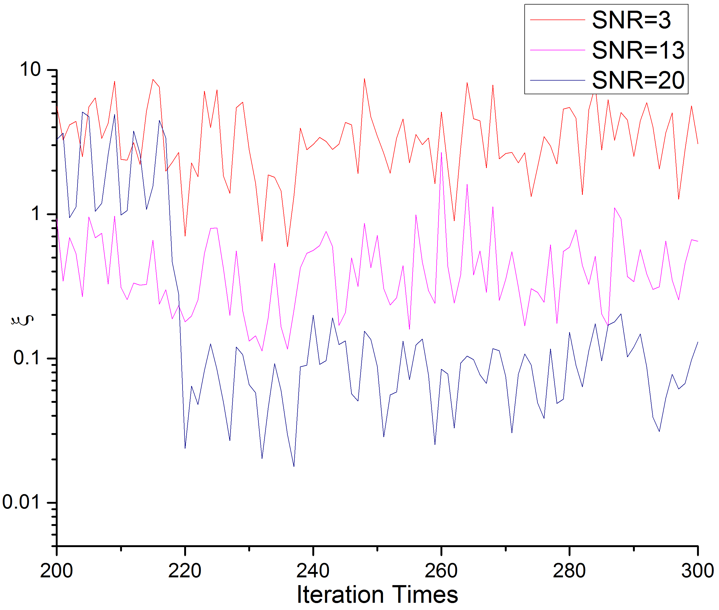
Application| Adaptive Modeling
Fig 3-3, Learning Curves

Slide 27
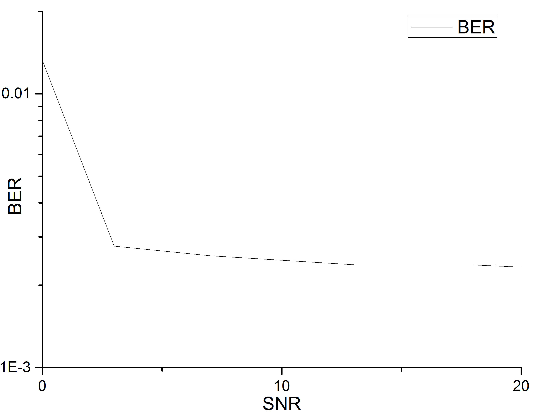
Application| Adaptive Modeling
Fig 3-4, BER/SNR

Slide 28
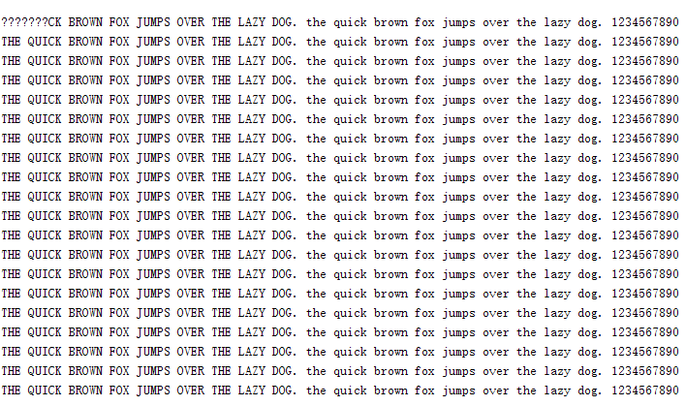
Application| Adaptive Modeling
Fig 3-5, Messages

Slide 29
THE END
Thanks for Your Listening

